Slide 1
Web-Based Presenter
Group Members
Maanas P K
Nandana K S
Sivada K M

Slide 2
Introduction
Using PowerPoint in a web browser lets you create and share basic presentations. It is possible to work simultaneously with others and present slide show from anywhere. But web-based PowerPoint doesn’t include all the features that desktop PowerPoint does. In this project, modern HTML5 is used to create markup to structure the slides, CSS is used to style the slides and add some effects, and JavaScript is used to trigger these effects and reorganize the slides based on click events. The goal of this project is to create an editable web-based presenter. The user can create presentation slides. The project is built with PHP, JavaScript, HTML, and CSS. MySQL is used to store the data. The user can write the contents on the slides, the contents will be stored in the tables in the MySQL database, while updating in the slides the contents get updated in the database.

Slide 3
Abstract
This project aims to develop a web-based presenter that can be edited. The user can create presentation slides. The project is developed using PHP, JavaScript, HTML and CSS. The data is stored in MySQL. HTML is used to give the basic mark-up to the project, CSS is used for styling the slides, JavaScript is used for handling clicks on left and right icons, handling full screen and small screen modes, handling different buttons and to move to different slides. PHP is integrated to it for making the slides editable.

Slide 4
Work Plan
Our aim was to develop a web-based presenter that can also be edited.
We have developed the project in 3 phases.
In the first phase,we have collected the information and created slides for the presenter.
In the second phase,we have completed the front-end using HTML,CSS and JavaScript.
In the third phase,we have used MySql for the database and php to edit the slides.

Slide 5
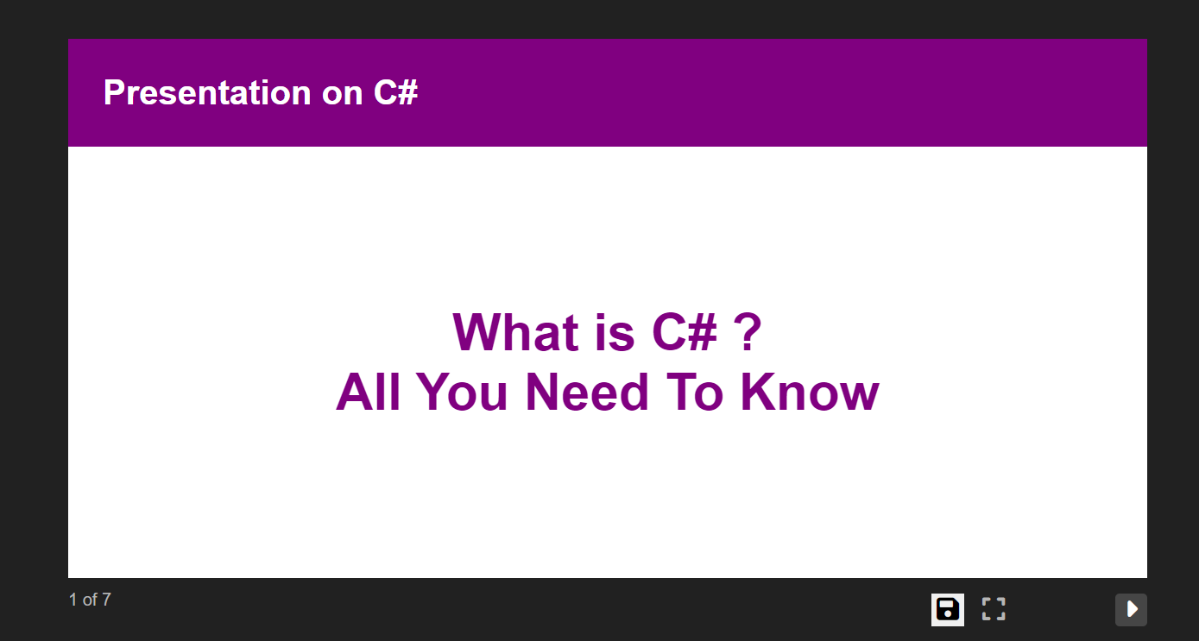
Output

Slide 6
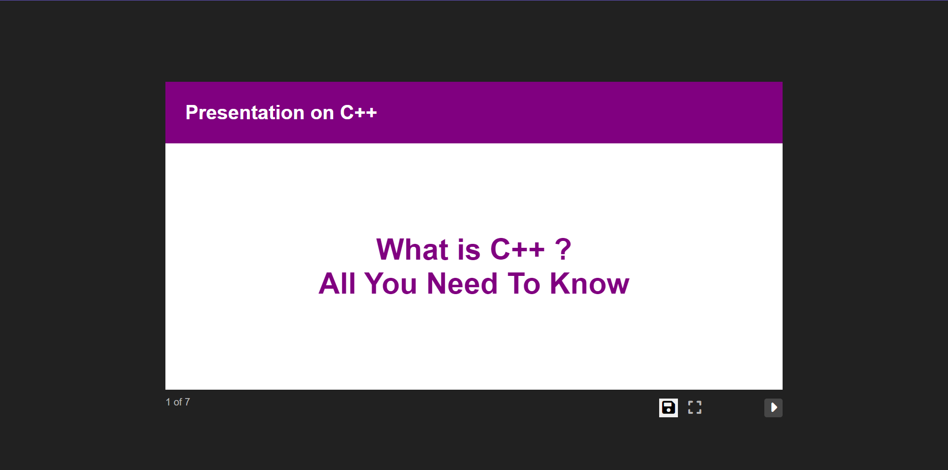

Slide 7
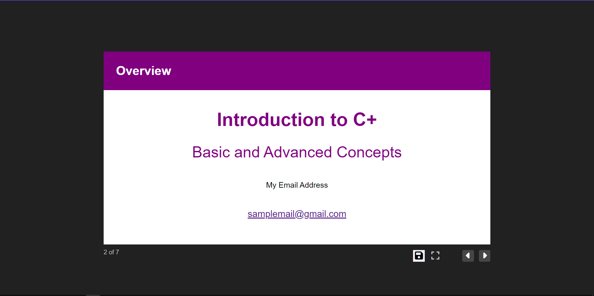

Slide 8
